Slide 1
Queues

Slide 2
Definitions
A queue is a linear abstract data type such that insertions are made at one end, called the rear, and removals are made at the other end, called the front.
Queues are sometimes called FIFOs: first-in first-out.
  enqueue() → Queue → dequeue()
The two basic operations are:
enqueue: adds an element to the rear of the queue.
dequeue: removes and returns the element at the front of the queue.
→Software queues are similar to physical ones: queuing at the supermarket, at the bank, at cinemas, etc.

Slide 3
    q = new QueueImpl() q → []
    q.enqueue(a) q → [a]
    q.enqueue(b) q → [a,b]
    q.enqueue(c) q → [a,b,c]
    q.enqueue(d) q → [a,b,c,d]
    q.dequeue() → a q → [b,c,d]
    q.dequeue() → b q → [c,d]
    q.enqueue(e) q → [c,d,e]
    q.dequeue() → c q → [d,e]
    q.dequeue() → d q → [e]
→ Elements of a queue are processed in the same order as the they are inserted into the queue, here “a” was the first element to join the queue and it was the first to leave the queue: first-come first-serve.”

Slide 4
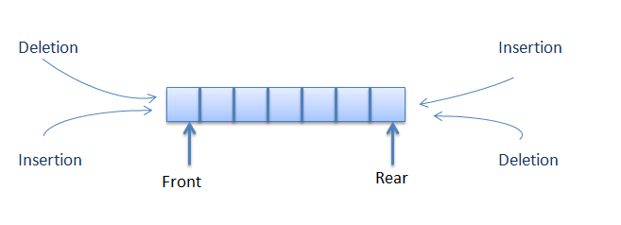

Ex.

Slide 5
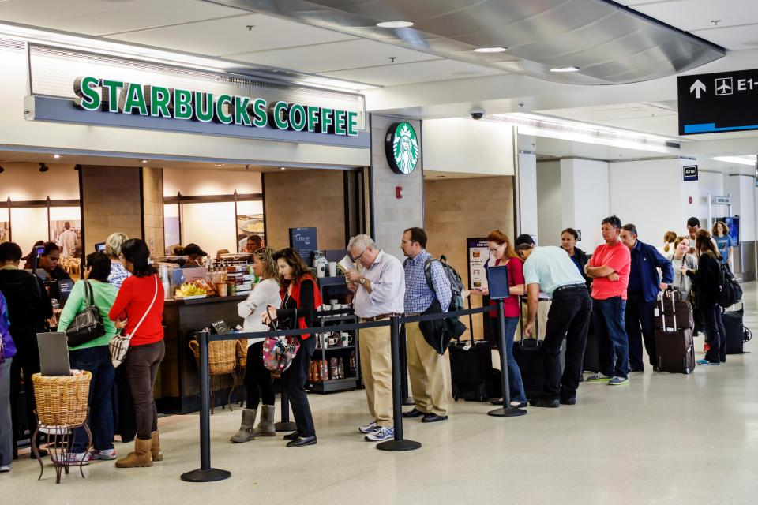
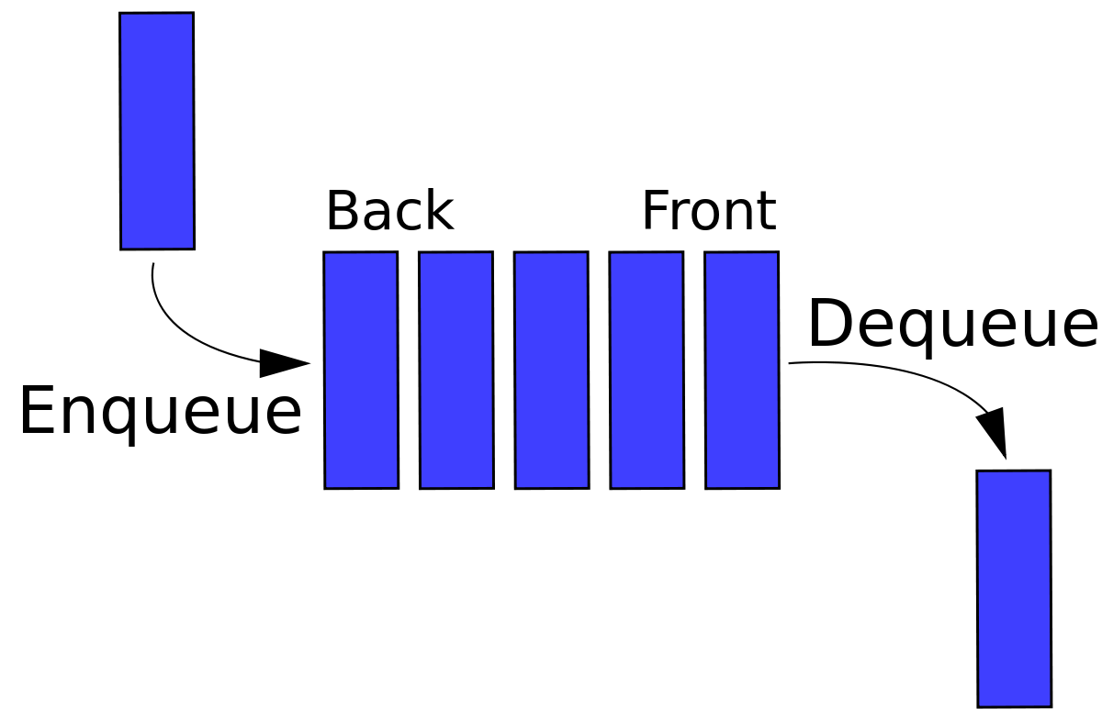
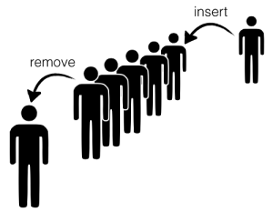

Slide 6
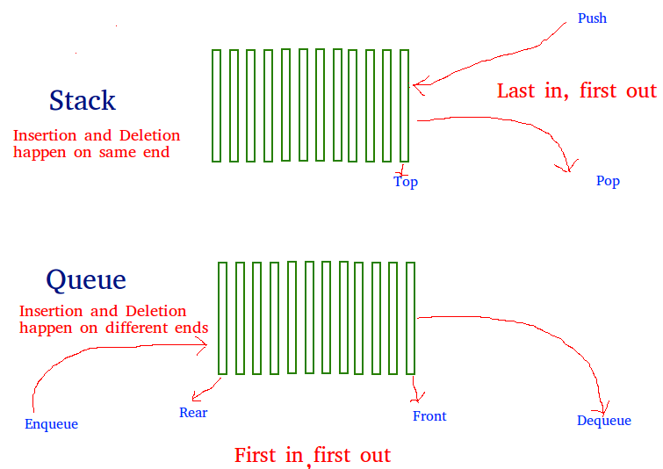
Different :→STACK /QUEUE

Slide 7
Topics
Queue
  Implementation of Queue
  Usage of Queue

Slide 8
Queue
Queue: First In First Out (FIFO)
Toll Station
  Car comes, pays, leaves
Check-out in Big Y market
  Customer comes, checks out and leaves
More examples: Printer, Office Hours, …
Input
D
C
B
A
Output

Slide 9
More Examples of Queue
In our daily life
  Airport Security Check
  Cinema Ticket Office
  Bank, ATM
  Anything else ?

Slide 10
What Is Queue
Queue is an abstract data type
Adding an entry at the rear
Deleting an entry at the front
Adding
Deleting
C
B
A
rear
front

Slide 11
Abstract Data Types
Queue
  Operating on both ends
  Operations: EnQueue(in), DeQueue(out)
enqueue
C
B
A
dequeue
rear
front

Slide 12
Queue
Queue is FIFO ( First-In First-Out)
A queue is open at two ends. You can only add entry (enqueue) at the rear , and delete entry (dequeue) at the front.
Note that you cannot add/extract entry in the middle of the queue.

Slide 13
Array Implementation of Queue
n-1
3
2
1
0
D
C
B
A
Max_Size
rear
front
After A leaves,
n-1
3
2
1
0
D
C
B
Max_Size
rear
front

